Slide 1

US Consumer’s
Income, Expenditure, and
Inflation

Slide 2
US Consumer’s
Income, Expenditure, and
Inflation

Slide 3
Introduction
US Consumer’s
Income, Expenditure, and
Agenda
Conclusion
Data and Analysis
Inflation
Insights

Slide 4

Data and Analysis
Examining and analyzing the relationship between consumer spending, income allocation, and inflation in the U.S. Economy
The Hypothesis is that changes in consumer expenditure act as catalysts for price increases across various industries, leading to inflationary pressures
Introduction

Slide 5

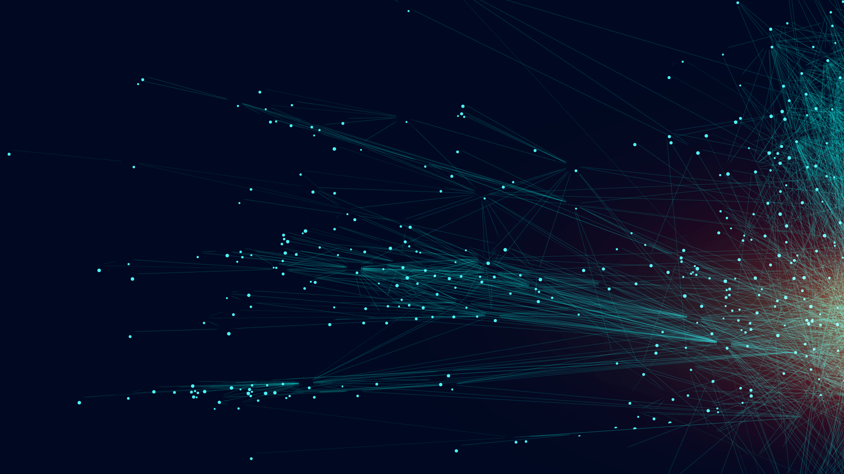
Insights
2021 - 2023
Income
Inflation
Consumer Income Data (Bureau of Economic Analysis)
80% of total income is disposable income and 20% deducted as tax at source
Wages and salaries from private and government sectors make up 56% of personal income on average
Consumer Price Index (Bureau of Labor Statistics)
Essential items like gas, bread, milk, and electricity are inflating, with milk and gas showing higher rates
Expenditure
Consumer Expenditure Data (Bureau of Economic Analysis)
Savings down to 3-4% post-2021, while spending up 8% yearly, signaling a shift to consumption
Data and Analysis
Introduction

Slide 6

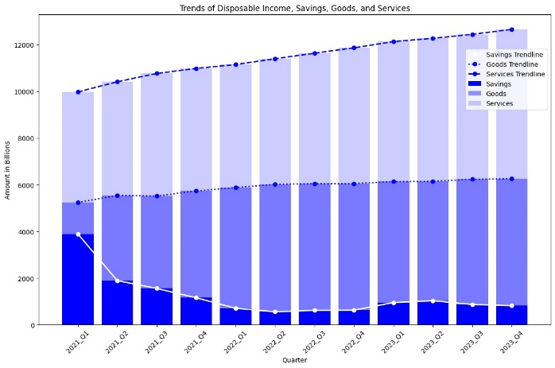
Stark contrast in personal expenditures and savings trends:
Personal expenditures surged, especially in services.
Savings witnessed a significant decline.
Upward trajectory in service expenditures:
Service costs increased from $10 trillion to over $12 trillion.
Demonstrates a notable upward trend over the years.
Downward trend in savings:
Savings declined from around $4 trillion to approximately $1 trillion.
Reflects a consistent decrease in savings over time.
Insights
Data and Analysis

Slide 7
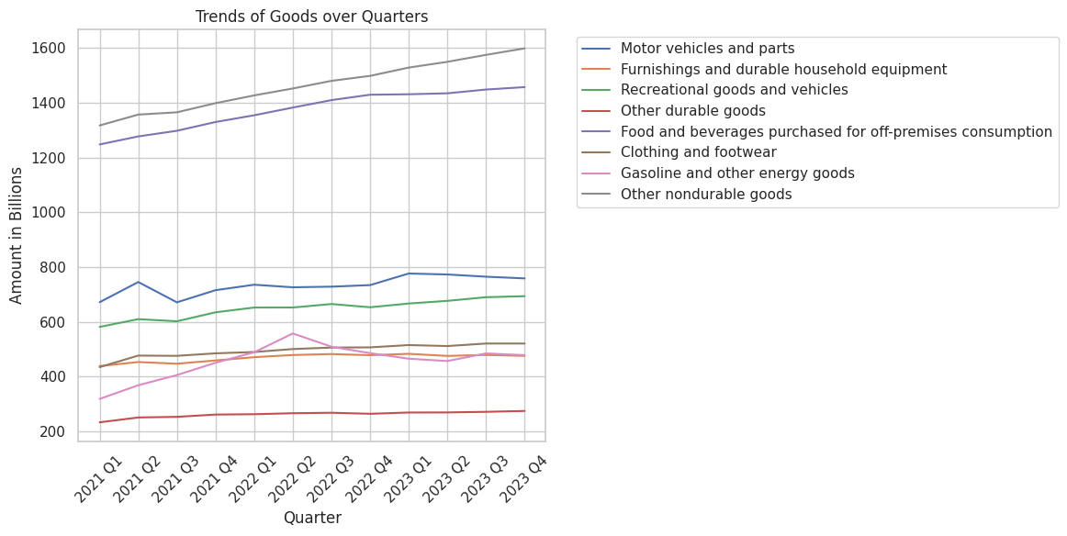
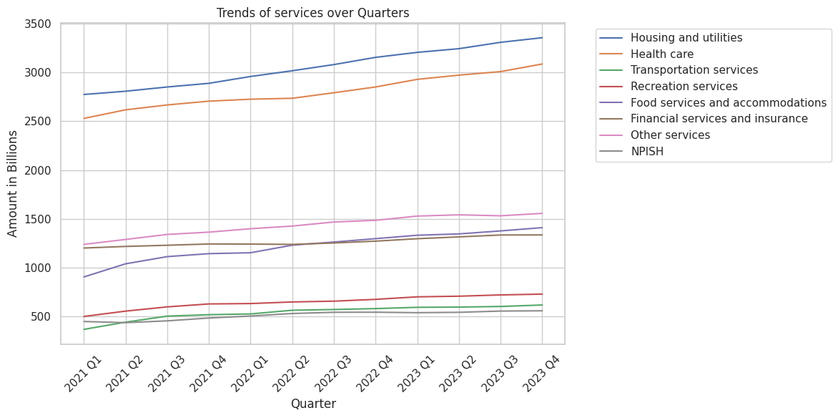
Goods Category:
Non-durable items (e.g., personal care products, household supplies, miscellaneous items, off-premises food and beverages) dominated expenses
Exceeded $1.6 trillion and $1.4 trillion marks, respectively
Other goods remained below the $0.8 trillion threshold in expenditure share
Insights
Services Category:
Costliest categories (housing, utilities, healthcare) surpassed $2.5 trillion initially
By the last quarter, experienced a remarkable surge
Reached nearly $3.5 trillion and $3 trillion, respectively
Indicates a significant increase over time

Slide 8
Insights
Correlation between consumer spending and inflation:
Direct correlation observed between spending on goods/services and inflation rates.
CPI index peaked at over 295 in the last quarter.
Spending trends:
Services spending consistently doubled goods spending.
Service expenses reached over $12 trillion at peak inflation.
Impact of economic downturns:
Sectors like housing, healthcare, restaurants, and non-durable goods heavily impacted.
Expenditures in these areas can significantly reduce disposable income, exacerbating inflationary pressures.

Slide 9
01
02
03
Complex Relationship
The report highlights the intricate interplay between consumer spending, income allocation, and inflationary pressures on the economy
Direct Relationship
It emphasizes the direct correlation between increases in goods and services and the corresponding rise in inflationary costs, as evidenced by the Consumer Price Index (CPI).
Disparity in Spending
Service expenditures consistently outpaced goods expenditures, indicating significant differences in consumer preferences and spending habits.
Conclusion
04
05
Impact of Elevated Inflation
Elevated inflation, driven by excessive demand for goods and services, poses broader implications, particularly during economic downturns, affecting sectors such as housing, healthcare, restaurants, and non-durable goods
Stimulus Measures
During economic downturns, targeted stimulus packages and social welfare measures aimed at supporting vulnerable populations can supplement essential resources and foster consumer confidence, facilitating sustainable economic growth.

